Slide 1
Certificate in Junior Python Data Analyst: Presentation
Group member :
LAM Yin Yung, Alice (02)
CHEUNG Chung Yin, Jacky(13)
CHOI Koon Chee, Christina (17) NG Chun Wa, Jackie (19)

Slide 2
Business idea
We aim to expand businesses for a existing bakery shop through internet
Customers will be able to register baking classes/ self-service baking studios, order cakes, and order baking tools online

Slide 3
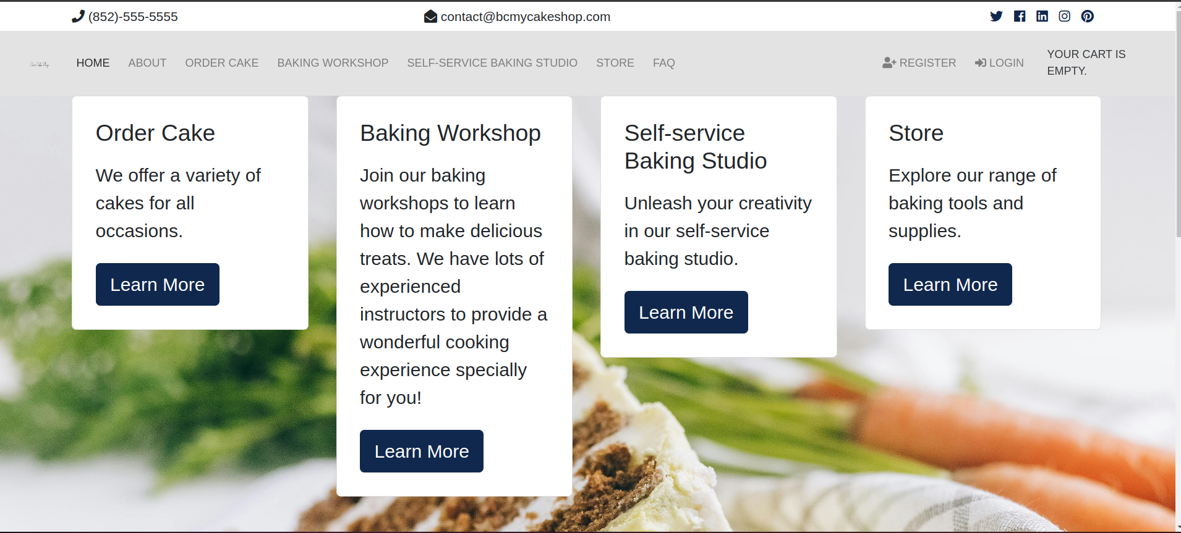
Four Line of Business

Slide 4
Shop 3:
Self-service baking studio

Slide 5
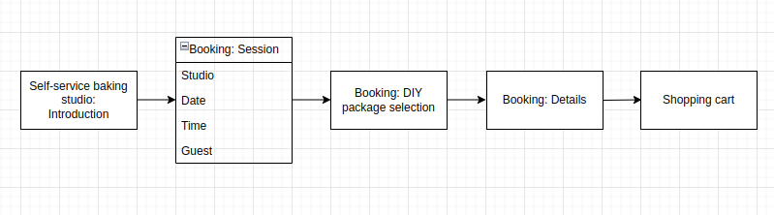
Self-service baking studio

Slide 6
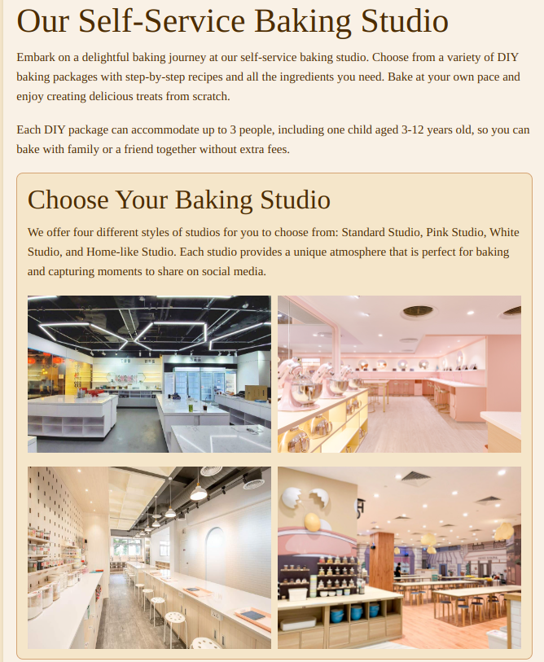
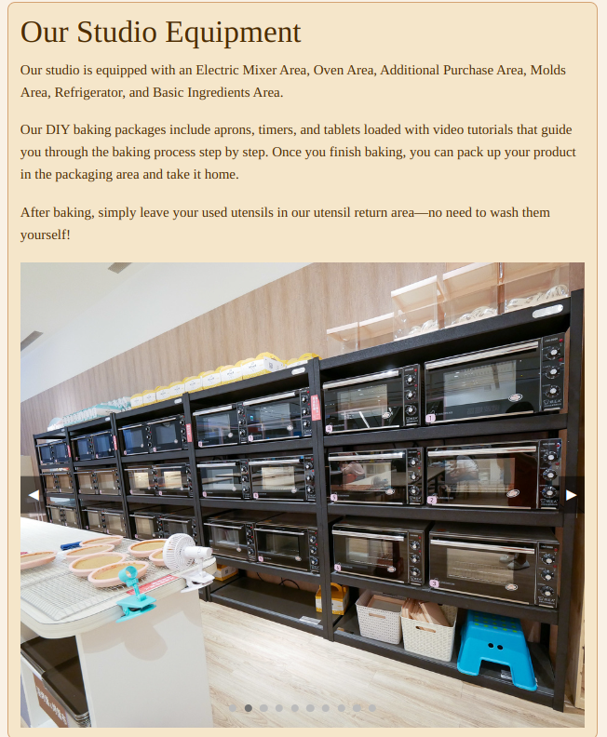
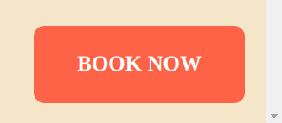

Slide 7
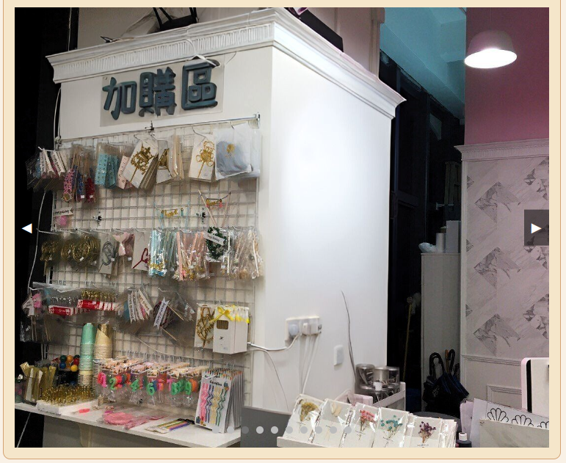
Image gallery:
Functions showImage, show Next Image, and show Previous Image handle image transitions and dot updates
Booking button:
CSS - Fixed Position
scroll up and down the page, the button will stay in the bottom-right corner of the viewport

Slide 8
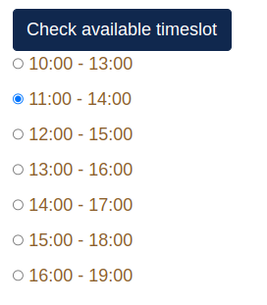
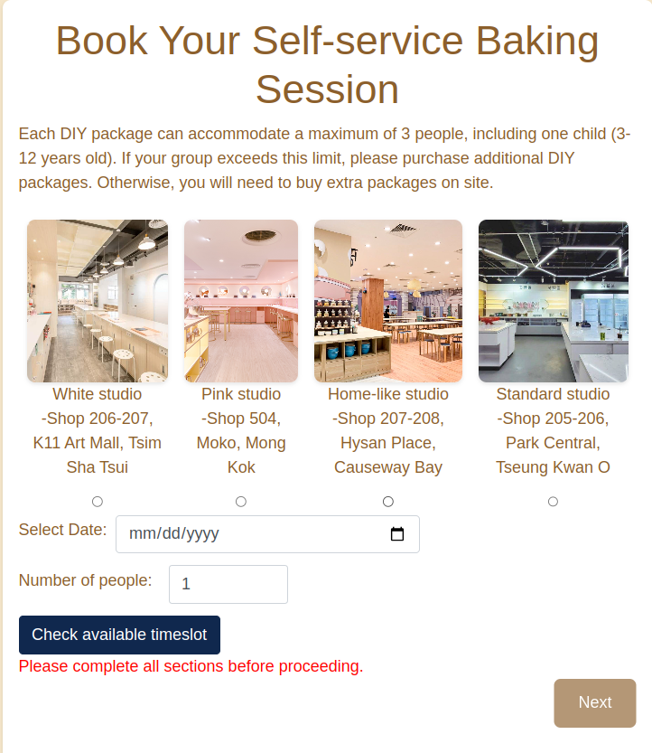
Breadcrumb
Error Message:
A message displayed if there are errors.
Validate Form Function:
Check if all required fields are filled.
Enables or disables the next button based on the validation.

Slide 9
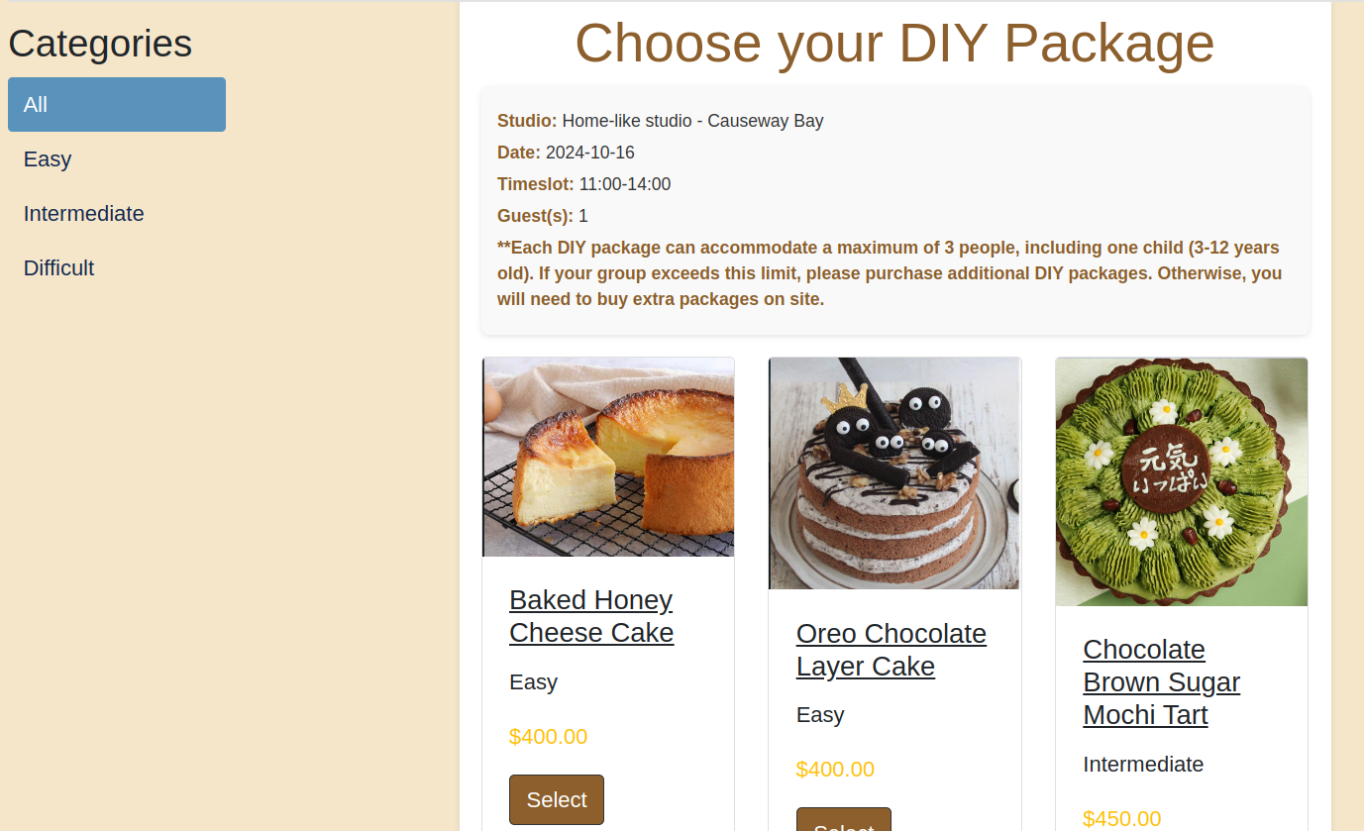
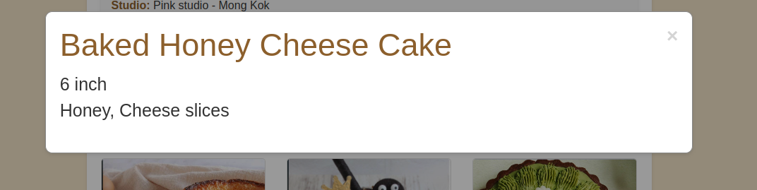
Breadcrumb
Hidden fields
A form to select the product, including hidden fields to pass additional information (studio name, district, address, date, time slot, and number of guests)
Sidebar
Popup functionality

Slide 10
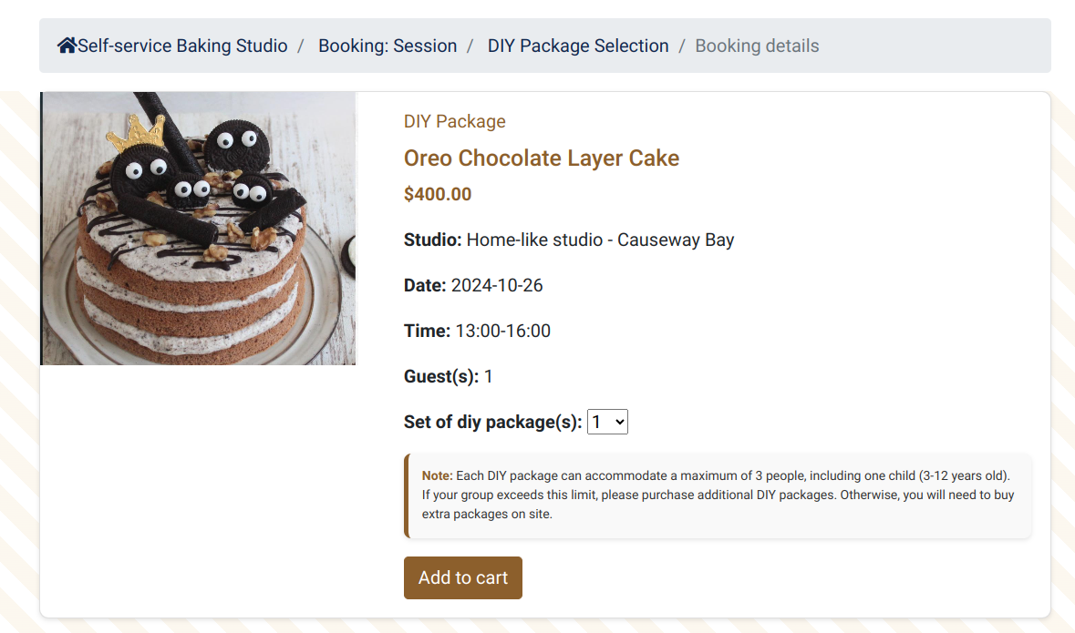
Breadcrumb
Hidden fields
A form to select the product, including hidden fields to pass additional information (studio name, district, address, date, time slot, and number of guests)

Slide 11
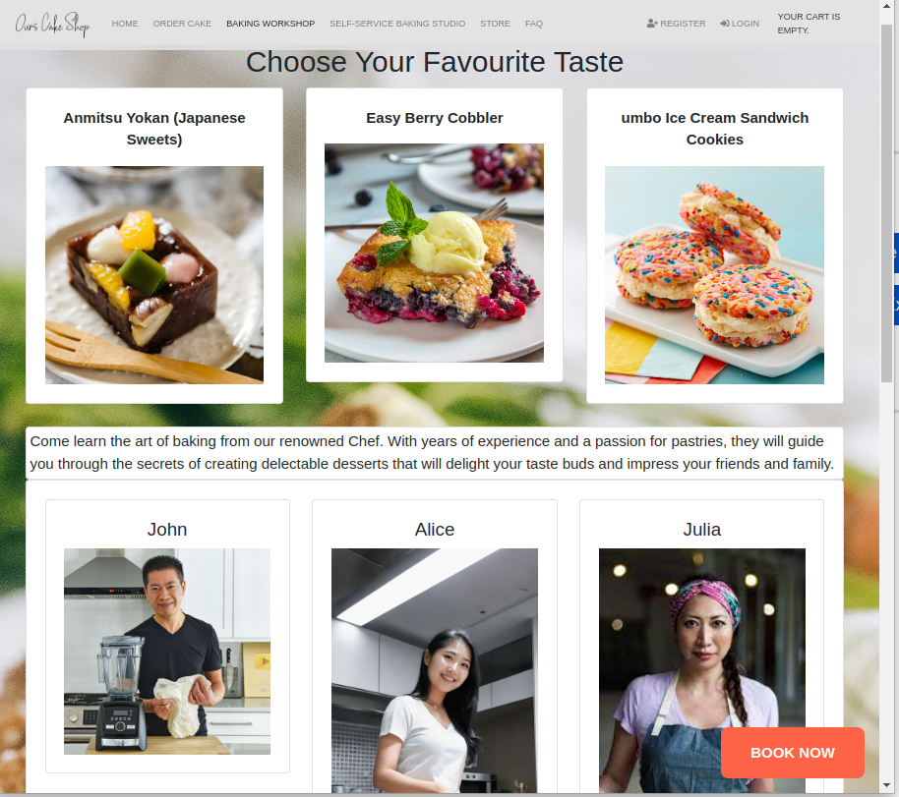
Shop 2 - baking lessons
3 courses
Japanese Sweets
Easy Berry Cobbler
Jumbo Ice Cream Sandwich Cookie
3 instructors
Chef John
Chef Baron
Chef Julia

Slide 12
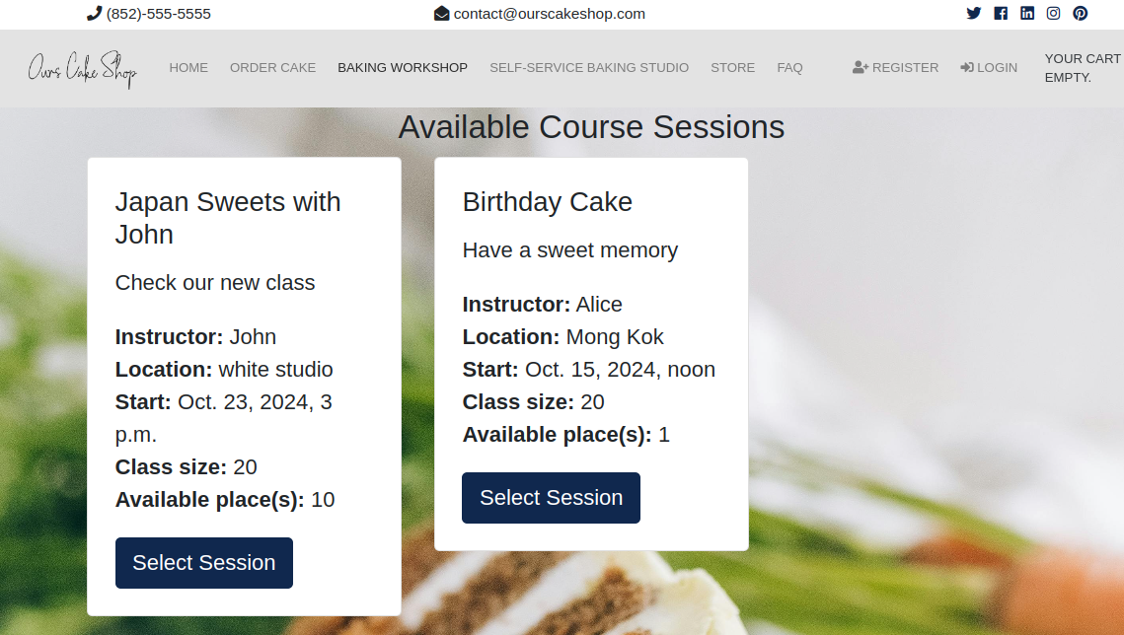
Course Session Selection

Slide 13
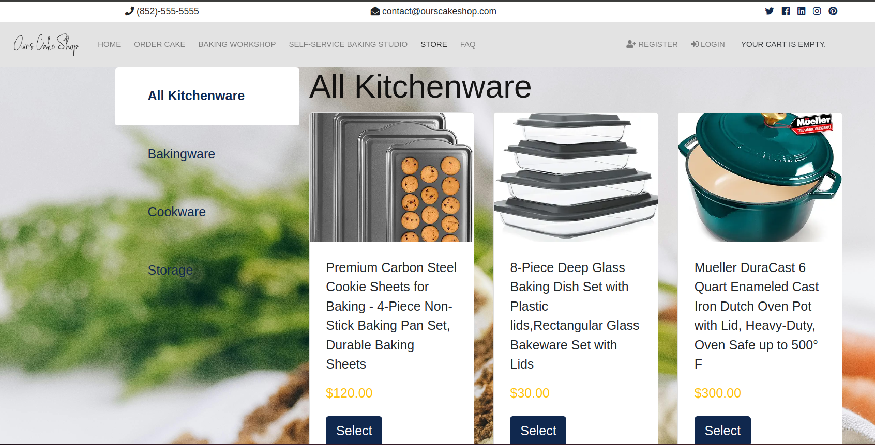
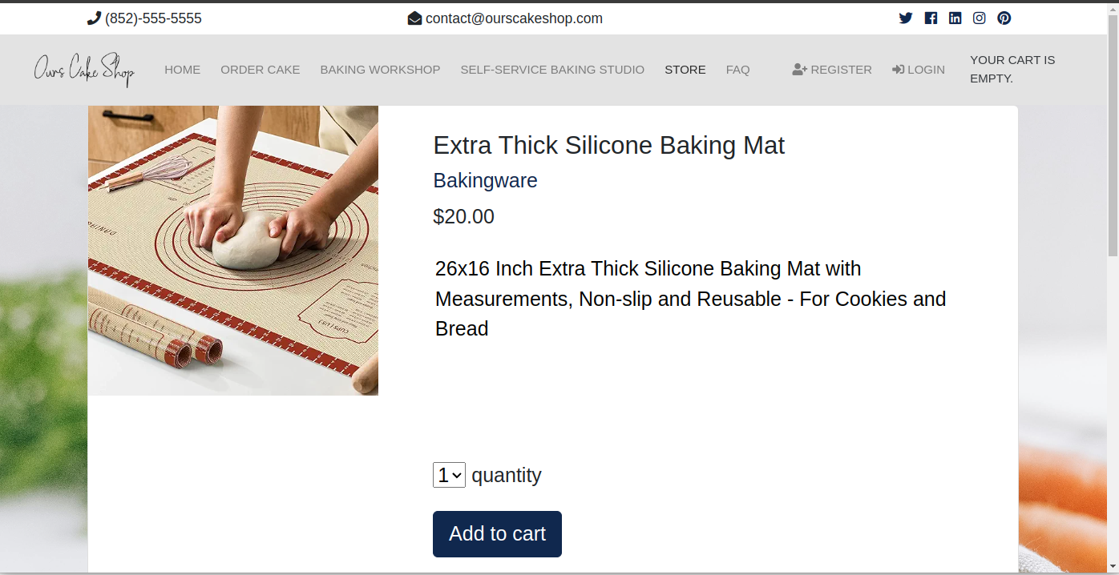
Shop 4 - Store

Slide 14
Demo

Slide 15
Ready Available vs New build
Quick delivery
Proven
Workable model prebuilt
Choice for better solution
Need to understand the original design and coding
Affect user requirement
Need to built additional data items and logic

Slide 16
Project Approach
User Requirement.
Developer Knowledge on business practice
The model, workflow and functions provided by the base system

Slide 17
Challenges
Different types of talent within the group
Not familiar with HTML (input form and passing parameter , CSS, Python (e.g. variable scope)
R&D on django advance feature

Slide 18
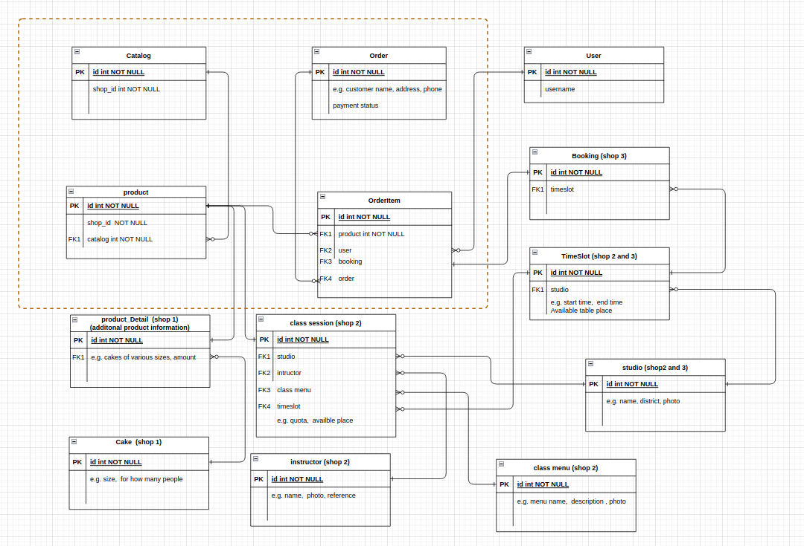

Slide 19
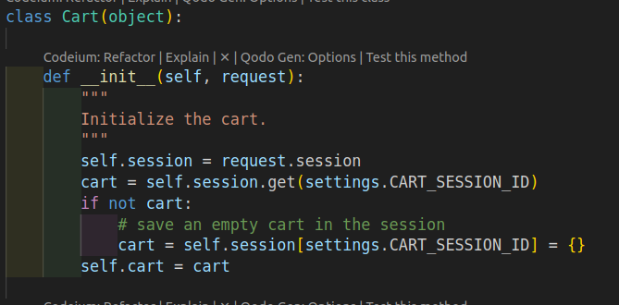
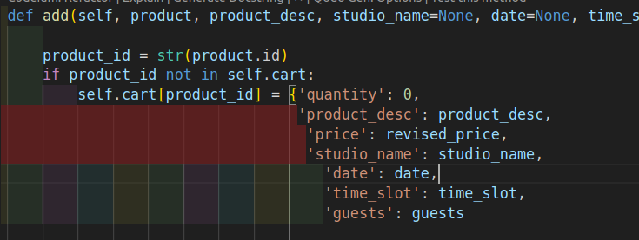
Shopping Cart

Slide 20
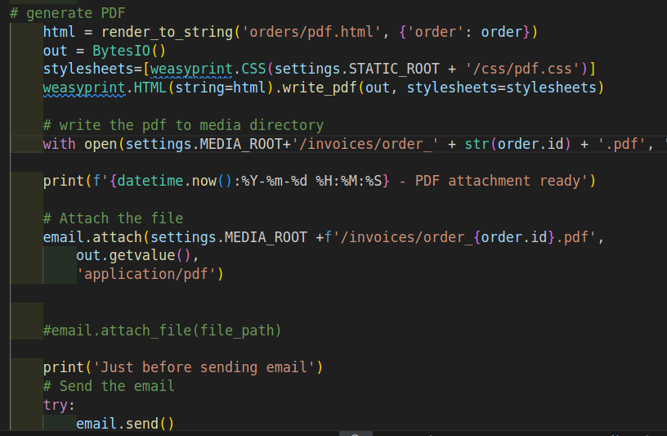
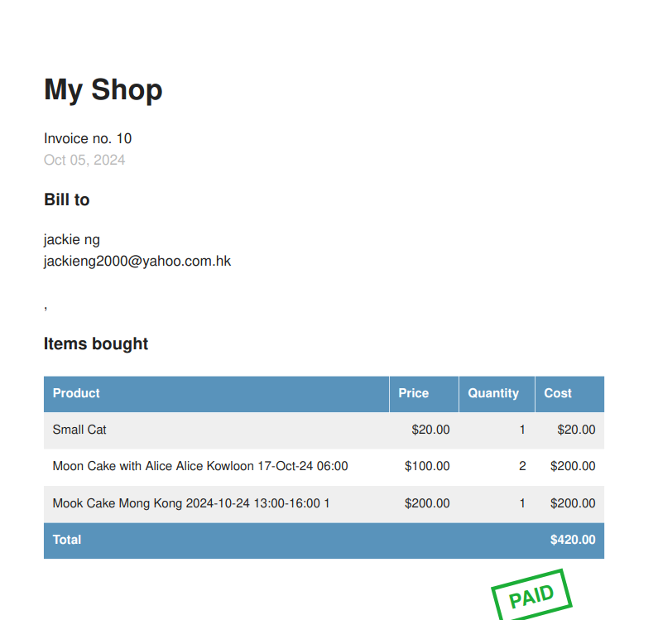
Send email with Order Attachment (using wesaprint)

Slide 21
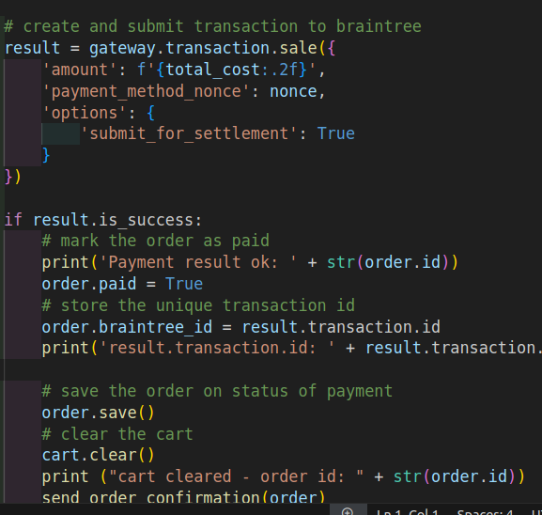
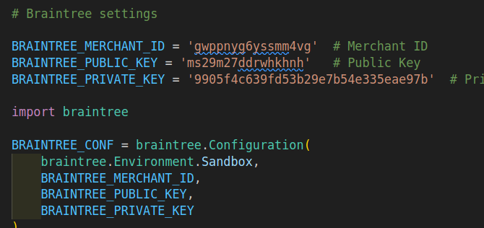
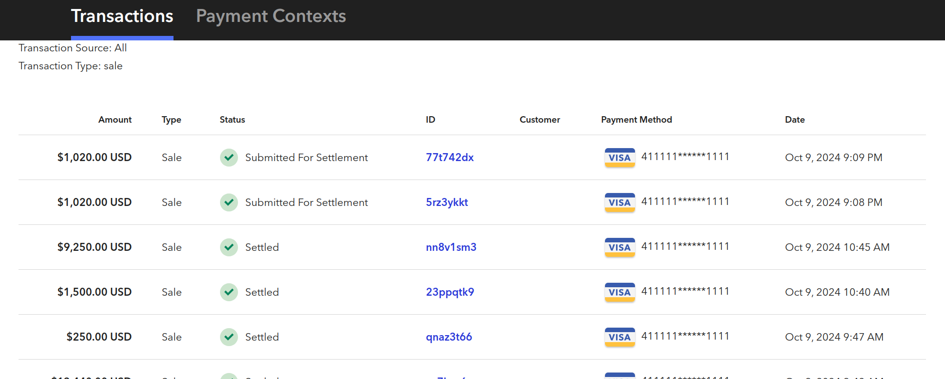
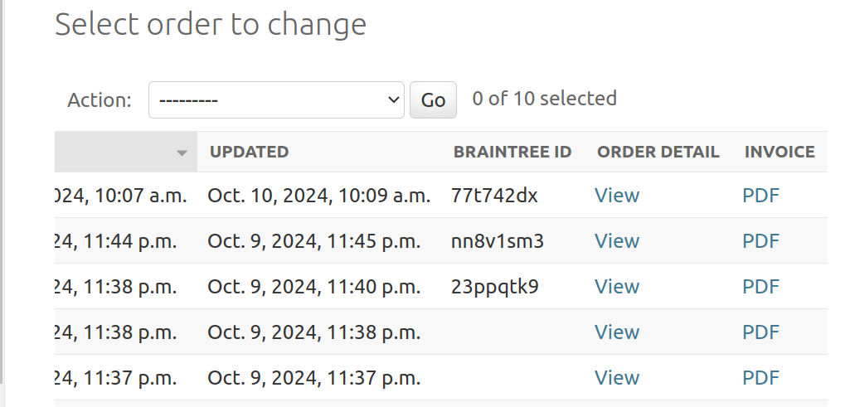
Payment Integration (brain tree)

Slide 22
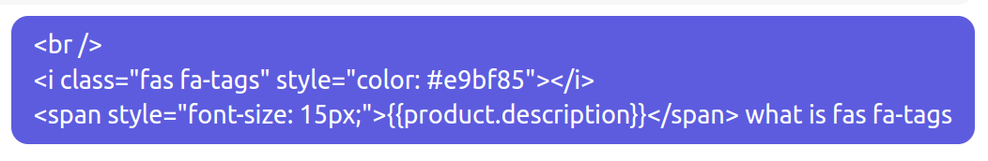
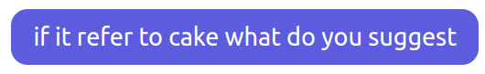
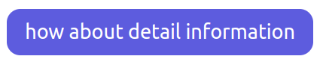
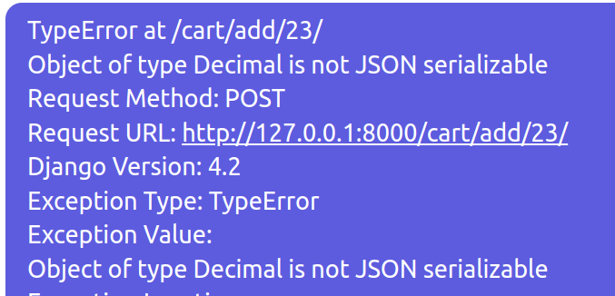
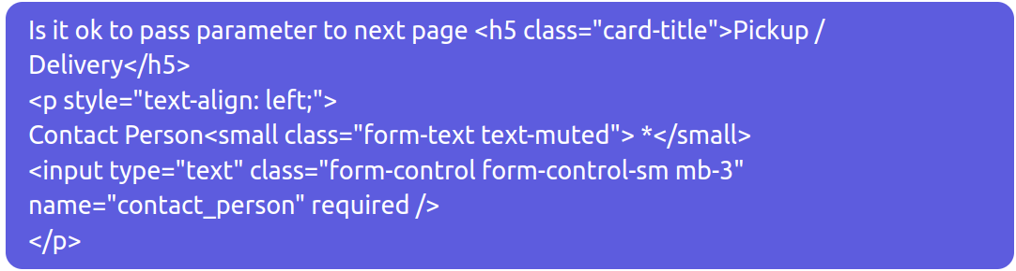
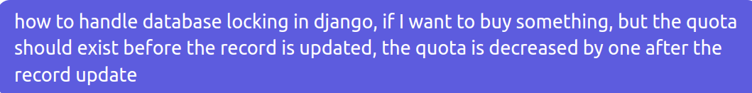
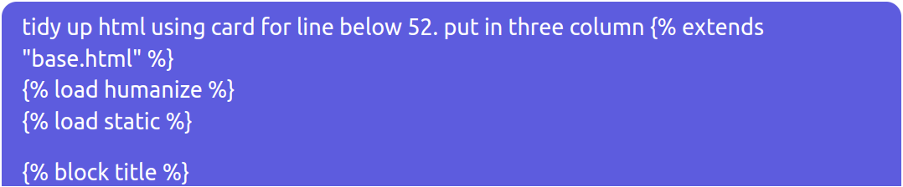

Slide 23
THANK YOU

